Slide 1
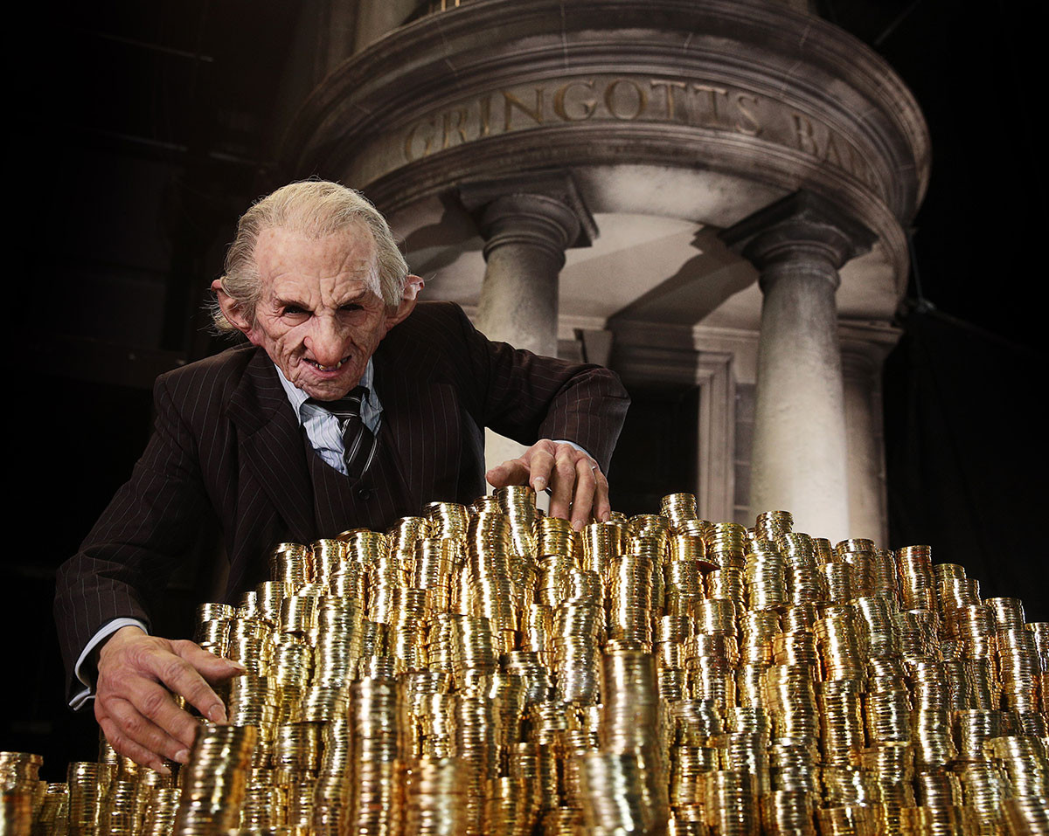
Better Understanding Our Customers
Lily Potter

Slide 2
Intro
Project steps
Setup Tools
Tasks and responsibilities
Work
Update repo
Tools we used

Slide 3


Business Question
What
What are the variables and characteristics that influence customer decision?
Who will accept a credit card offer?
Why
Targeting marketing efforts on customers who are likely to accept our offers
Making Sales aware of how a profitable lead is characterized
How
Development of a machine learning model to predict customer behaviour
Heatmap of characteristics, qualitative analysis

Slide 4
Business Question
What
What are the variables and characteristics that influence customer decision?
Who will accept a credit card offer?
Why
Targeting marketing efforts on customers who are likely to accept our offers
Making Sales aware of how a profitable lead is characterized
How
Development of a machine learning model to predict customer behaviour
Heatmap of characteristics, qualitative analysis

Slide 5



Process
Our Database and Results from Marketing
Cleaning, Wrangling, EDA,
Pre-processing, Predictions
Preparing graphs and results for management
Extract to .csv and import to tableau
Extraction with SQL

Slide 6
Process
5th
hybrid: Smote, Tomek, dropping Q1, Q2, Q3, Q4
73% accuracy score
1st No sampling technique. 94% but no positive
4th Drop columns (no of bank accounts)
71% accuracy score
2nd
SMOTE sampling technique 72% accuracy score
3rd
random oversampling
69 % accuracy

Slide 7
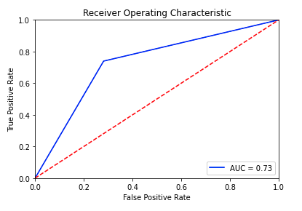
Results
We are able to predict with auc 73%
We can target marketing activities more precisely
Savings per customer?
Characteristics of an “accepter”
Preferred Reward – “Air Miles”
Homeowner
Income Level low– medium, usually no overdraft protection
1-2 accounts

Slide 8
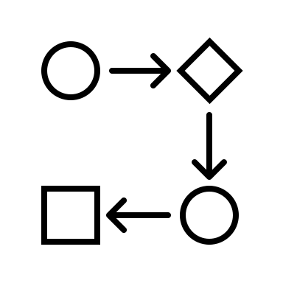

Next Steps
Transfer the developed method into business processes for marketing
Setup data streams from database into CRM system
Programming data processing
Creating dashboards for different marketing user groups
Training staff on how to run reports and amend them if necessary.
Should we sell the targeted person a credit card or not?
Correlation between prediction and credit rating?
Can we predict credit rating with a high accuracy?

Slide 9
Thank You!

